Slide 1
Scheimpflug Lidar Construction
Alejandro Antonio Castillo Gil
Edwar Stiven Montaño Cely

Slide 2
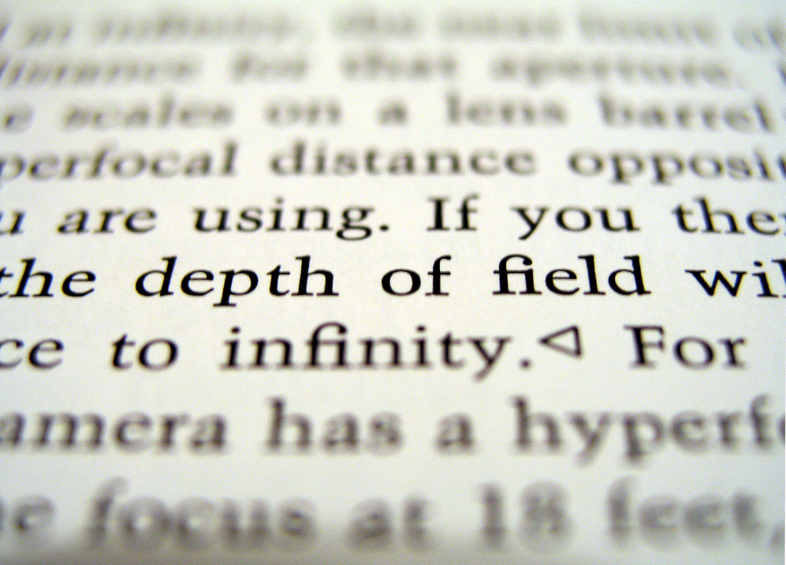
Scheimpflug principle
The Scheimpflug principle is the geometric rule that describes the orientation of the plane of focus, the lens plane, and the image plane of an optical system

Slide 3
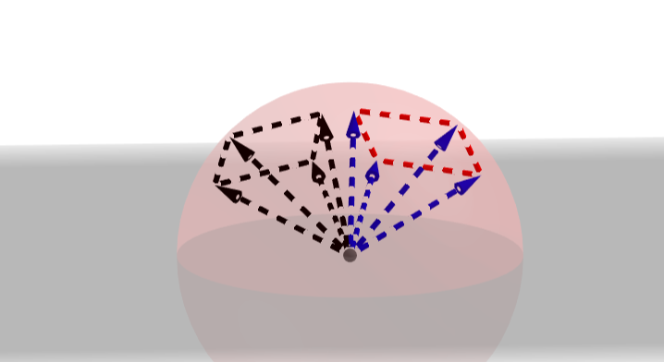
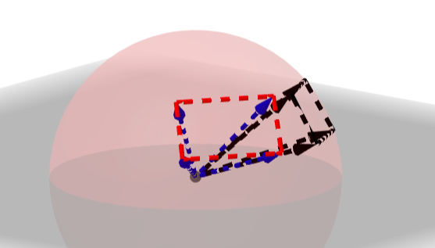
System Objectives
To obtaining an image dataset of particulate matter.
To capturing into a matrix array form.
To storing images for further processing and analysis.

Slide 4
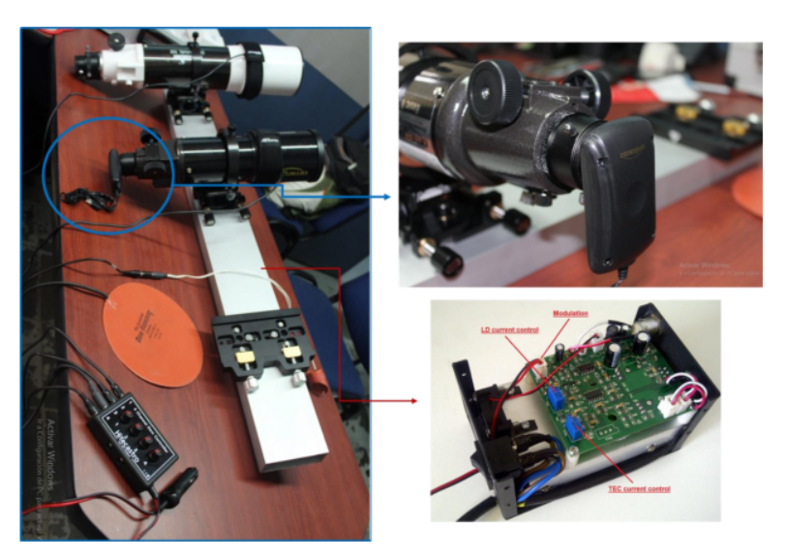
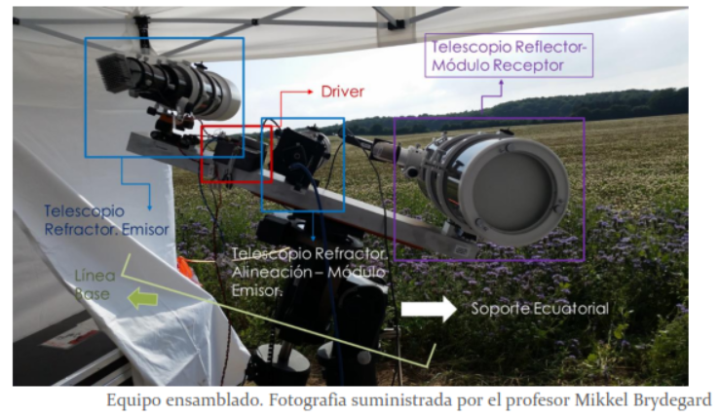
Physical Assembly

Slide 5
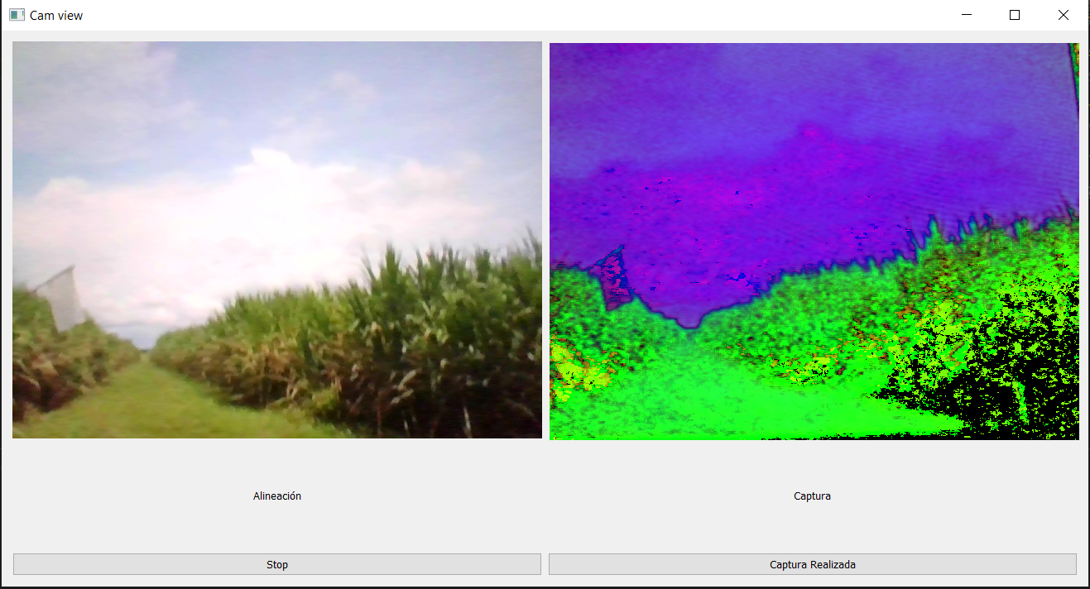

System capturing software

Slide 6
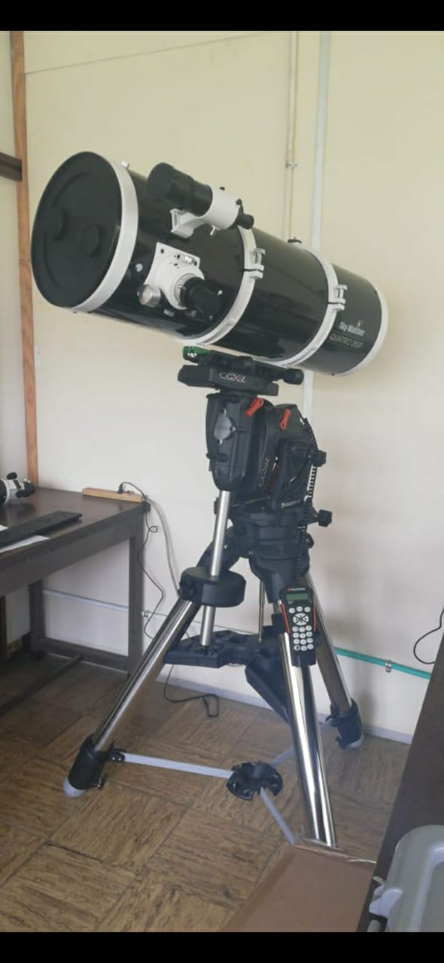
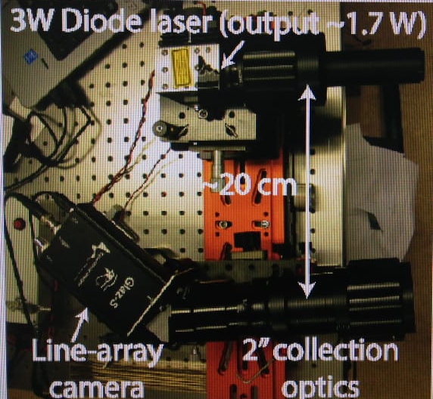
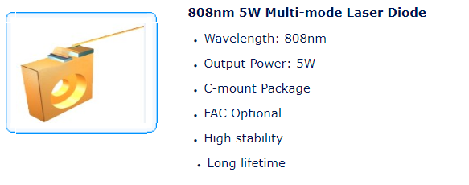
Provisional mounting of the Celestron telescope

Slide 7
Thanks for your attention
Any question?

